Slide 1


OBJECT ORIENTED ANALYSIS AND DESIGN
ONLINE SHOPPING CART SYSTEM
                Participants:
                SAKTHI SWATHI.M
                SHAJATHI BEE.M
                SHAMIRTHA.J
                SHARMILY.S

Slide 2
ABSTRACT
The system is a web-based platform designed for online shopping.
It allows users to browse products, add items to the cart, and make purchases.
It automates product management, order processing, and inventory updates.
It improves overall efficiency and reduces the need for manual work.
The system is secure, scalable, and easy for users to operate.

Slide 3
INTRODUCTION
Online shopping makes purchasing products quicker and more convenient.
The system provides easy product browsing and secure purchasing options.
It removes the limitations of traditional physical shopping.
It is developed using object-oriented design principles.
The system focuses on providing convenience and automation for users.

Slide 4
EXISTING SYSTEM
Customers must visit physical stores to buy products.
There are fewer product options available in local shops.
Manual billing often leads to delays and errors.
There is no proper way to track orders in the existing system.
Overall, the process is slow, tiring, and inconvenient.

Slide 5
PROPOSED SYSTEM
The new system offers a fully automated online shopping platform.
Users can easily browse, search for products, and make purchases online.
It provides secure login and safe payment options.
Admins can efficiently manage products, inventory, and customer orders.
The proposed system is faster, more convenient, and highly scalable.

Slide 6
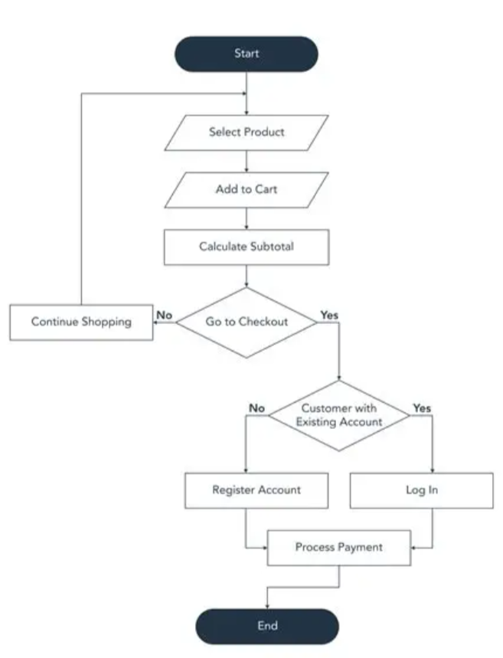
PROPOSED DIAGRAMS

Slide 7
MODULES
User Module
Admin Module
Product Catalog Module
Shopping Cart Module
Payment Module
Order Management Module

Slide 8
MODULES DESCRIPTION
User Module
The User Module allows customers to log in, browse products, add items to the cart, and place orders.
Admin Module
The Admin Module enables administrators to manage products,
stock levels, and orders.
Product Catalog Module
The Product Catalog displays product details for users to view.

Slide 9
MODULES DESCRIPTION
Shopping Cart Module
The Shopping Cart Module lets users add, remove, or update items in
their cart.
Payment Module
The Payment Module ensures secure and smooth checkout transactions.
Order Management Module
The Order Management Module helps track and update the status of customer orders.

Slide 10
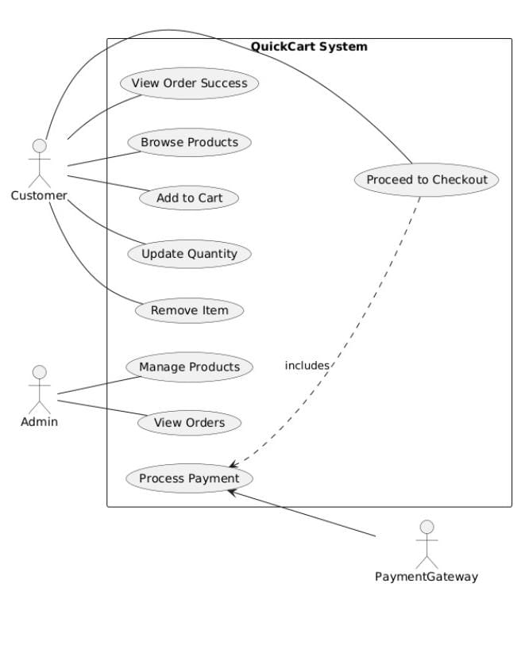
USECASE DIAGRAM

Slide 11
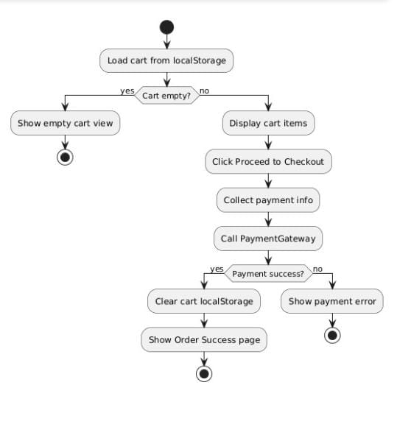
ACTIVITY DIAGRAM

Slide 12
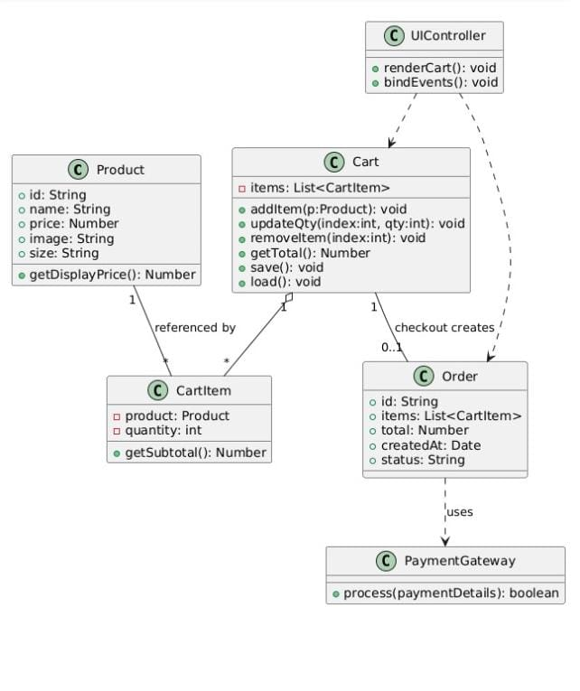
CLASS DIAGRAM

Slide 13
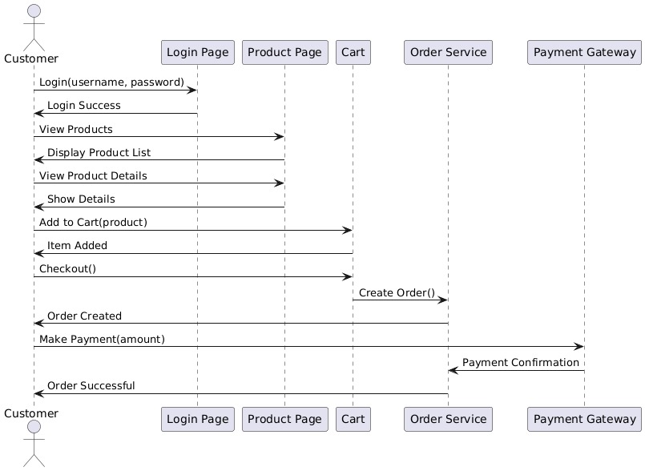
SEQUENCE DIAGRAM

Slide 14
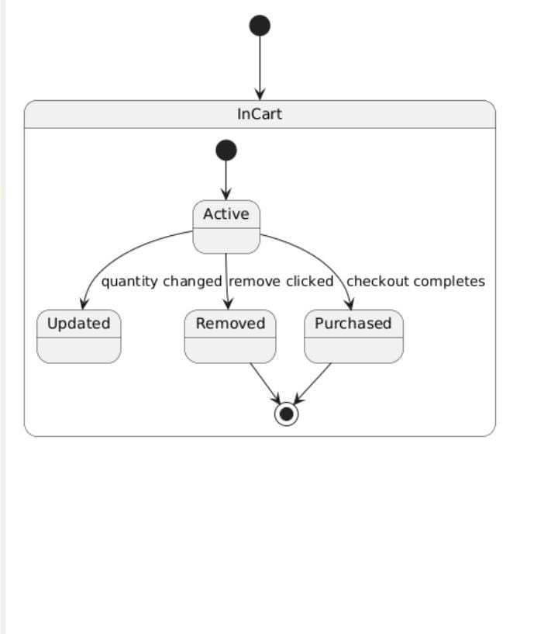
STATE MACHINE DIAGRAM

Slide 15
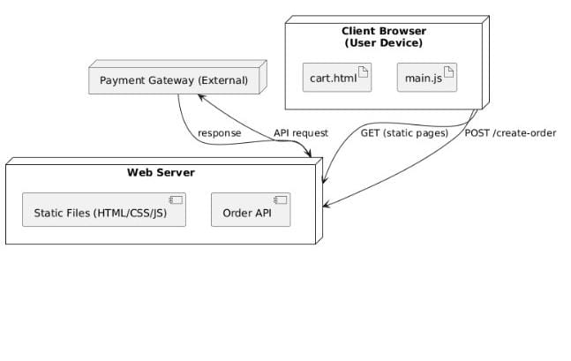
DEPLOYMENT DIAGRAM

Slide 16
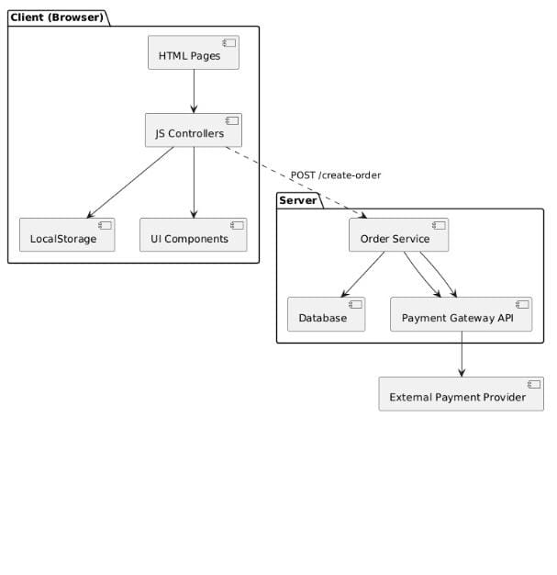
COMPONENT DIAGRAM

Slide 17
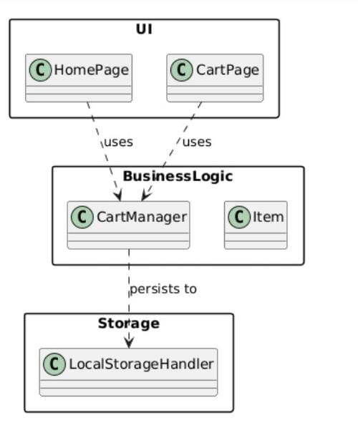
PACKAGE DIAGRAM

Slide 18
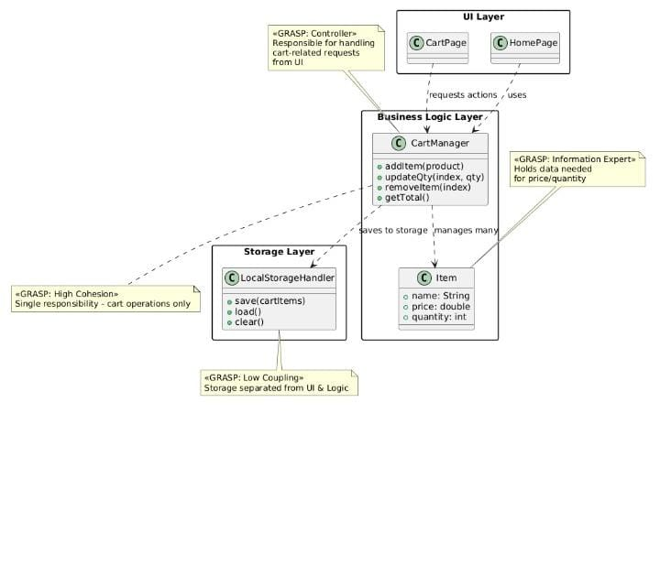
DESIGN PATTERN
(GRASP)

Slide 19
CONCLUSION
The Online Shopping Cart System successfully provides a reliable and user-friendly platform for online shopping.
It streamlines the purchasing process by allowing customers to browse, select, and buy products with ease while ensuring secure transactions.
For administrators, it simplifies product management, stock monitoring, and order tracking, making the system efficient for both buyers and sellers.
Overall, this project highlights how e-commerce applications can save time, reduce manual effort, and create a convenient digital marketplace.

Slide 20
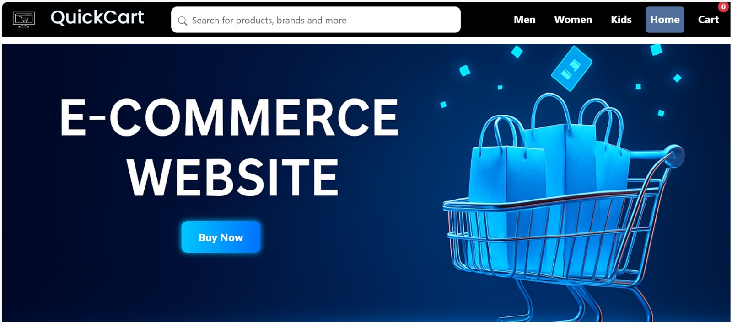
OUTPUT

Slide 21
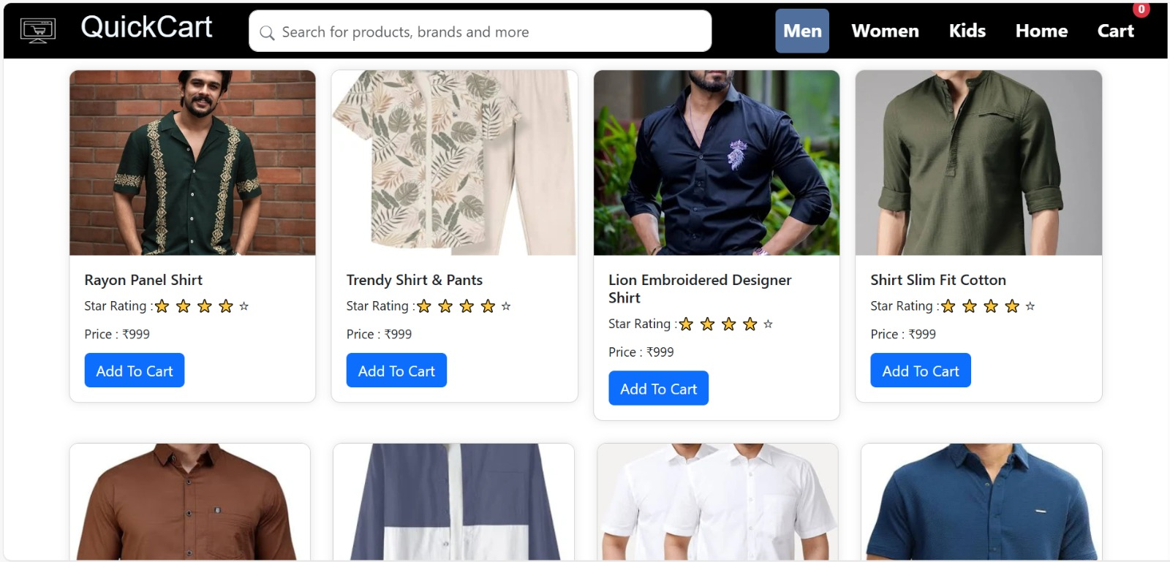
OUTPUT

Slide 22
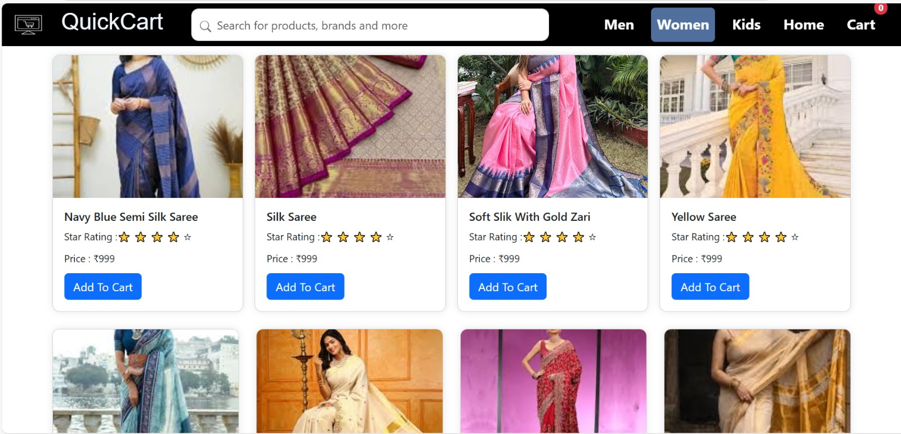
OUTPUT

Slide 23
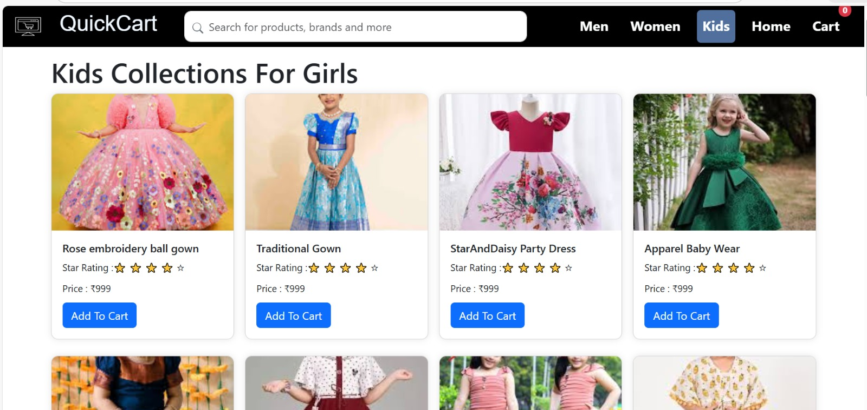
OUTPUT

Slide 24
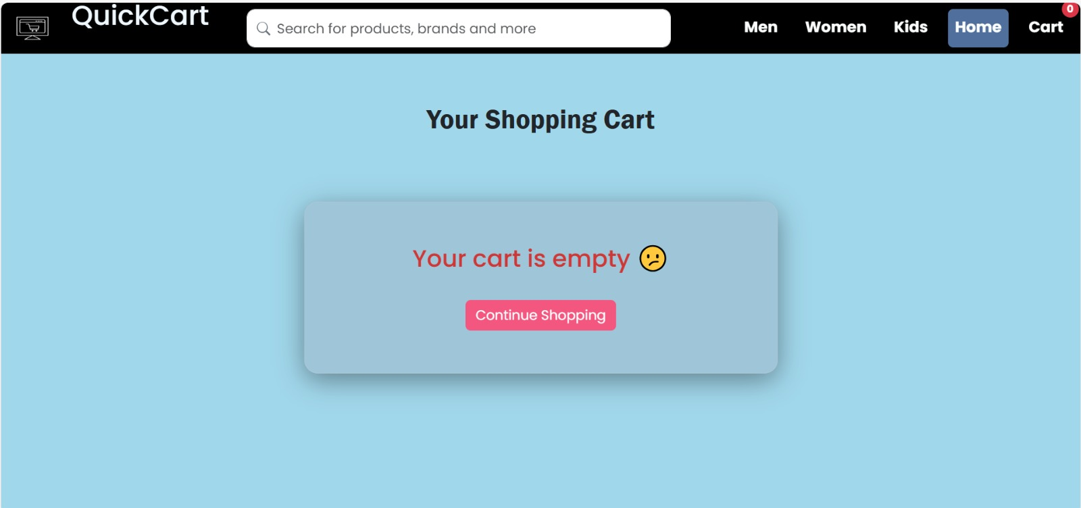
OUTPUT

Slide 25

OUTPUT

Slide 26
THANK YOU

